Slide 1
ELECTRIC TRAINING CENTRE GHAZIABAD
SPEEDOMETER DATA ANALYSIS
FZR DIVISION

Slide 2
CASE STUDY-1

Slide 3
SPEED WHILE APROACHING STOP SINGNAL AT DANGER
•
•
SPEED B4
1000
SPEED B4
500
SPEED B4 100
SPEED B4
10
5:42:36 AM
43
13
25
‘tt!t
t10
84
69
40 '
3
I•'!

Slide 4
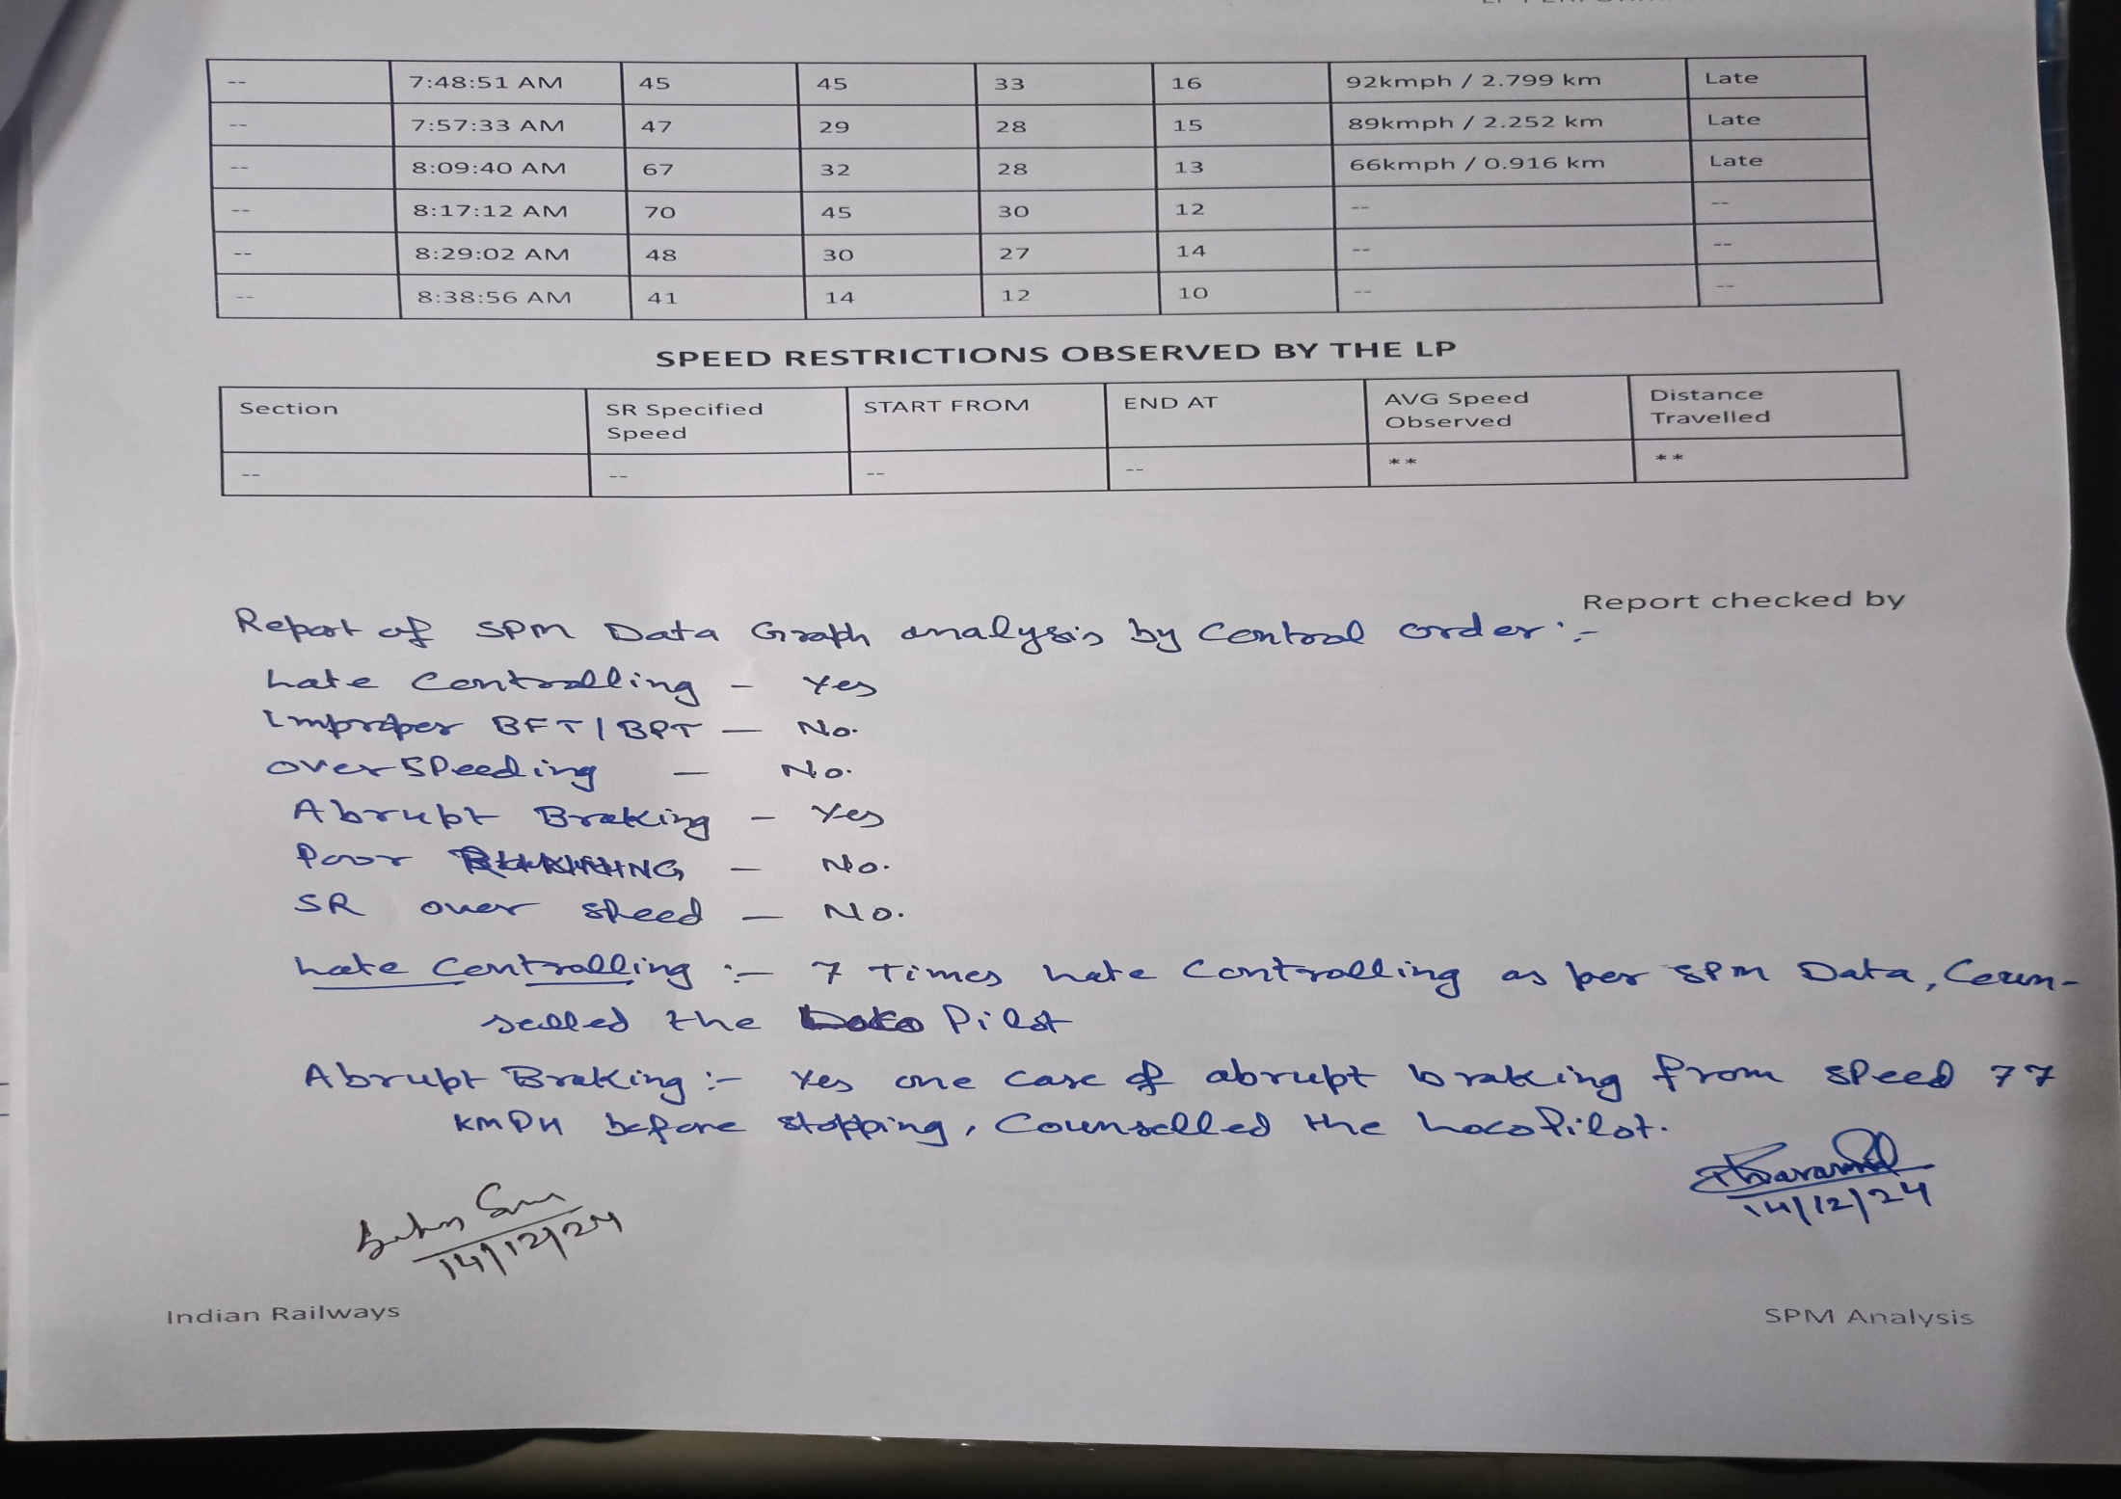

Slide 5
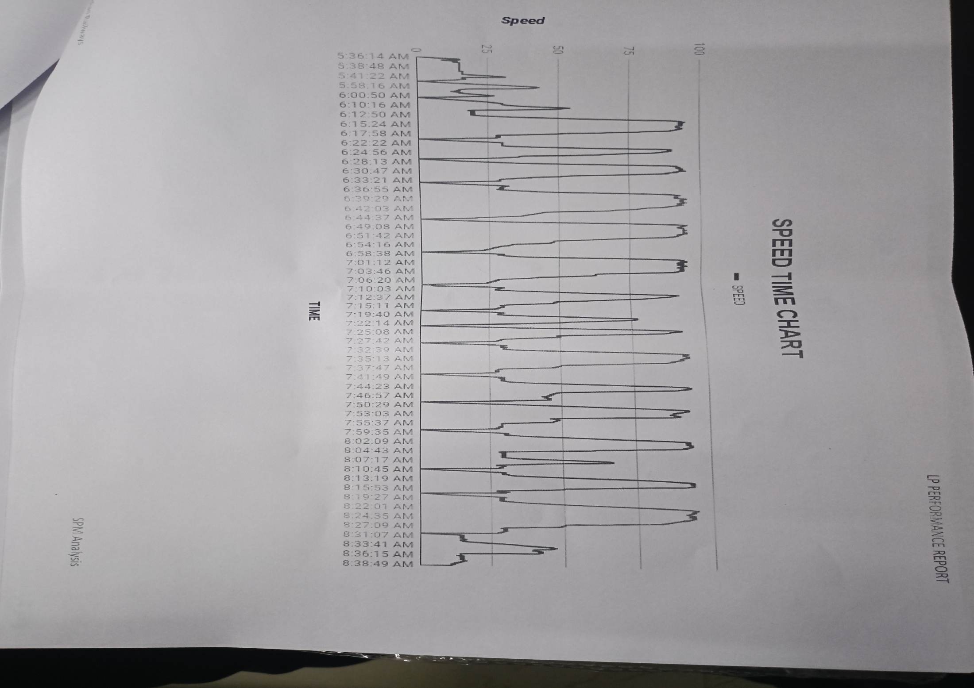

Slide 6
CASE STUDY-2

Slide 7
SPEEDOMETER DATA ANALYSIS-2
Journey Date: 12/12/2024
TRAIN ; No. 04631 (CHG)
Remarks:
Report ID: 131224/18778
Loco Number: 78034
Section: OTHER MEDHA
MPS attained: 95 kmph | Average Speed: 40.73 kmph
Total Distance: 122.72 km | Total Time: 3:00:48
Distance covered at near MPS: 48.76 km (speed>.95xMPS) | Time Range of Analysis: 7:00:02 AM - 10:00:56 AM
Late Controlling: YES Over Speeding: NO Improper BPT: NO | Abrupt Braking: YES Poor Running: NO SR Overspeed: NO
BPT @ 7:15:39 AM | SPEED DROP: 58 - 19 | BFT @ 7:00:30 AM | SPEED DROP: 7 - 3
SPEED WHILE APPROACHING STOP SIGNAL AT DANGER
SGNL | TIME/KM NO | SPEED B4 1000mtr | SPEED B4 500mtr | SPEED B4 100mtr | SPEED B4 10mtr | Speed at Controlling/ Braking Distance | BRAKING Technique
 | 7:25:20 AM | 45 | 26 | 25 | 12 | 92kmph / 1.757 km | Late
 | 7:34:56 AM | 46 | 29 | 26 | 12 | 92kmph / 2.231 km | Late
 | 7:43:13 AM | 47 | 43 | 25 | 15 | 93kmph / 2.483 km | Late
 | 7:50:00 AM | 82 | 60 | 31 | 12 | 93kmph / 1.486 km | Abrupt
 | 7:5S:22 AM | 47 | 29 | 27 | 16 | 84kmph / 1.652 km | Late
 | 8:12:52 AM | 36 | 14 | 14 | 8 | 93kmph / 3.078 km | Late
 | 8:24:43 AM | 83 | 56 | 32 | 16 | 91kmph / 2.098 km | Late
 | 8:33:26 AM | 46 | 35 | 29 | 17 | 93kmph / 2.64 km | Late
 | 8:41:33 AM | 71 | 51 | 24 | 16 | 94kmph / 2.51 km | Late
 | 8:45:02 AM | 76 | 57 | 30 | 10 | 75kmph / 0.723 km | Abrupt
 | 8:52:53 AM | 48 | 28 | 28 | 14 | 93kmph / 4.254 km | Late
 | 9:03:00 AM | 69 | 52 | 33 | 1S | 93kmph / 1.957 km | Late

Slide 8
LP PERFORMANCE REPORT
 | 9:07:41 AM | 71 | 52 | 28 | 10 | 82kmph / 1.333 km |  | Late
 | 9:15:03 AM | 52 | 30 | 28 | 14 | 93kmph / 2.261 km |  | Late
 | 9:35:25 AM | 81 | 46 | 31 | 17 | 93kmph / 1.32 km |  | Abrupt
 | 9:43:12 AM | 78 | 44 | 31 | 16
 | 9:49:08 AM | 94 | 56 | 30 | 16
 | 10:00:59 AM | 28 | 1S | 13 | 12
SPEED RESTRICTIONS OBSERVED BY THE LP
Section SR Specified START FROM Speed | END AT | AVG Speed Observed | Distance Travelled

Slide 9
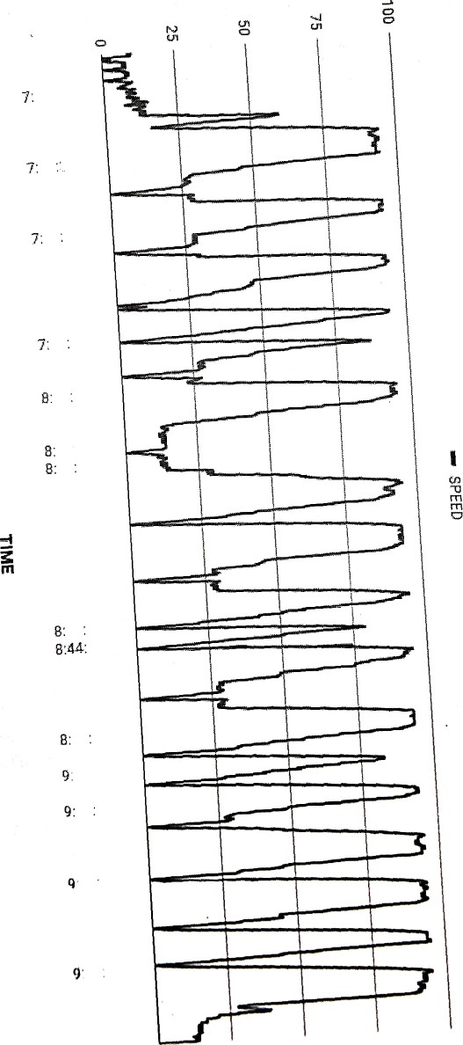

Slide 10
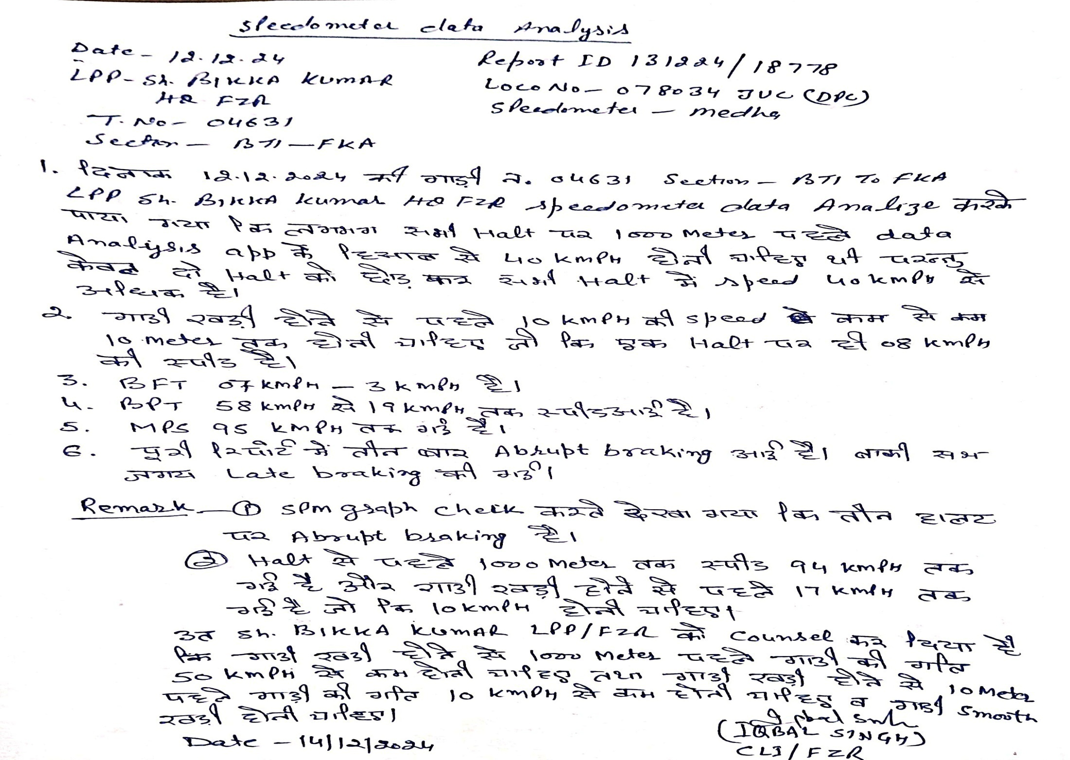

Slide 11
CASE STUDY-3

Slide 12
SPEEDOMETER DATA ANALYSIS-3
Journey Date: 19.12.2024
Train No. 12445 (CHG)
Remarks:
Report ID: 191224/13261
: Loco Number: 30704 Section: OTHER
MPS attained: 109 kmph | Average Speed: 49.72 kmph
Total Distance: 308.87 km | Total Time: 6:12:43
Distance covered at near MPS: 96.73 km (speed>.95xMPS) | Time Range of Analysis: 1:15:34 AM - 7:28:14 AM
Late Controlling: YES Over Speeding: NO Improper BPT: NO | Abrupt Braking: NO Poor Running: NO SR Overspeed: NO
BPT @ 1:25:08 AM | SPEED DROP: 61 - 28 | BFT @ 1:16:44 AM | SPEED DROP: 14 - 6
SPEED WHILE APPROACHING STOP SIGNAL AT DANGER
SGNL | TIME/KM NO | SPEED B4 1000mtr | SPEED B4 500mtr | SPEED B4 100mtr | SPEED B4 10mtr | Speed at Controlling/ Braking Distance | BRAKING Technique
-- | 2:02:50 AM | 35 | 21 | 14 | 7 | 95kmph / 3.601 km | Smooth
-- | 3:45:53 AM | 24 | 24 | 10 | 6 | 25kmph / 1.321 km | Smooth
-- | 4:38:40 AM | 30 | 26 | 13 | 7 | 78kmph / 2.589 km | Smooth
-- | 5:40:13 AM | 42 | 24 | 9 | 6 | 78kmph / 3.739 km | Late
-- | 5:51:40 AM | 16 | 15 | 7 | 3 | 16kmph / 0.998 km | Smooth
-- | 6:39:07 AM | 32 | 26 | 8 | 7 | 52kmph / 1.561 km | Smooth
-- | 7:24:25 AM | 32 | 26 | 12 | 7 | 71kmph / 11.437 km | Smooth
SPEED RESTRICTIONS OBSERVED BY THE LP
Section | SR Specified Speed | START FROM | END AT | AVG Speed Observed | Distance Travelled
-- | -- | -- | -- | ** | **

Slide 13
TRAIN NO 12445
LOCO NO 30704/WAP7/GZB SECTION-LDH---SVDK
Loco Pilot conducted BPT at 01:16:44 hrs, and speed reduced from 14 KMPH to 6 KMPH.
Loco Pilot conducted BPT at 01:25:08 hrs, and speed reduced from 61 KMPH to 28 KMPH.
LP speed should be 40 KMPH instead of 42 KMPH before 1000 Mts, 25 KMPH before
500 Mts, 15 KMPH before 100 Mts, and 10 KMPH before 10 Mts before red signal.
All other factors found
Over-speeding: No
Abrupt braking: No
Improper BPT: No
Poor running: No
SR overspeed: No
:
All other points found normal during train working.
LP counselled to control speed under 40 KMPH before 1000 Mts, 25 KMPH before 500 Mts, 15 KMPH before 100 Mts, and 10 KMPH before 10 Mts before red signal.
Loco Pilot working found satisfactory, and all other factors found good.

Slide 14
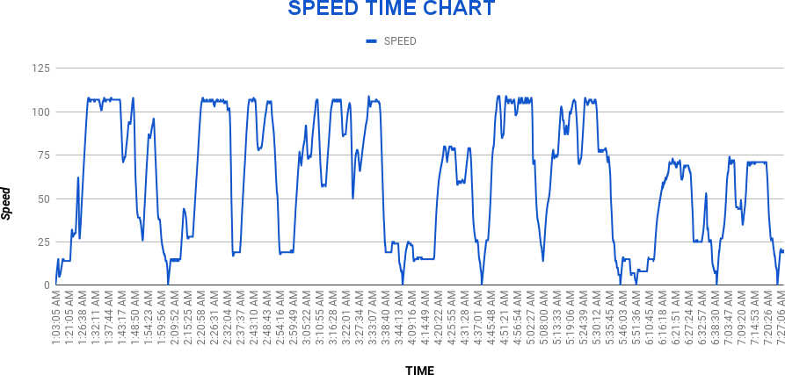
LP PERFORMANCE REPORT
Indian Railways
SPM Analysis

Slide 15
CASE STUDY-4

Slide 16
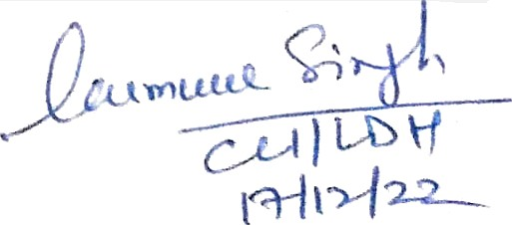
SPEEDOMETER DATA ANALYSIS-4
Journey Date: 16.12.24
TRAIN No. 146S3 (CHG)
Remarks: HSR-LDH
Report ID 1612Z4/1566S
Loco Number: 30794 Section: OTHER ALTOMETER
MPS attained: 112 kmph | Average Speed: S3.97 kmph
Total Distance: 1Z9.9S km | Total Time: 2:24:30
Distance covered at near MPS: 98.04 km /speed>.95xMPS) | Time Range of Analysis: 12•06•16 AM - 2:30'43 AM
Late Controlling: No Over Speeding: NO {olproper BPT: NO | Abrupt Braking: NO Poor Running: NO SR Overspeed: NO
BPT @ 32:12:44 AM | SPEEO DROP: 74 - 24 | BFT @ 12:06:51 AM
SPEED WHILE APPROACHING SYOP SIGNAL AT DARGER
SGNL | TIME/KM NO | SPEED B4 1£@0mtr | SP£cO e» 5tA)mtr | 5Pz D B4 1fX ntr | 5rezD B4 1omtr | st›eea «I Co troii›ng/ Braking Distance | seAKING Technique
 | l2:S4:IlAM | 29 | 24 | 18 |  | 107kmph / 3.264 km | Smooth
 |  |  | 2S | 14 |  | 109kmph / 2.4z8 km | Smooth
 | l:1 :14Ah# | 14 | 14 | 15 |  | 108kmph / 3.171 km | Smooth
 | 1:46:36 AM | 33 | 25 | 20 |  | 1 08kmph / 3.7B km | g
 | 2:07-5AM | 14 | 14 | 13 |  | 1fBkmph / 3.197 km | g
SPEED RESTRICTIONS OBSERVED BY THE LP
Sect on | SR Specified Speed | SSART FROM | END AT | AVG Speed | £Xstance Travelled

Slide 17
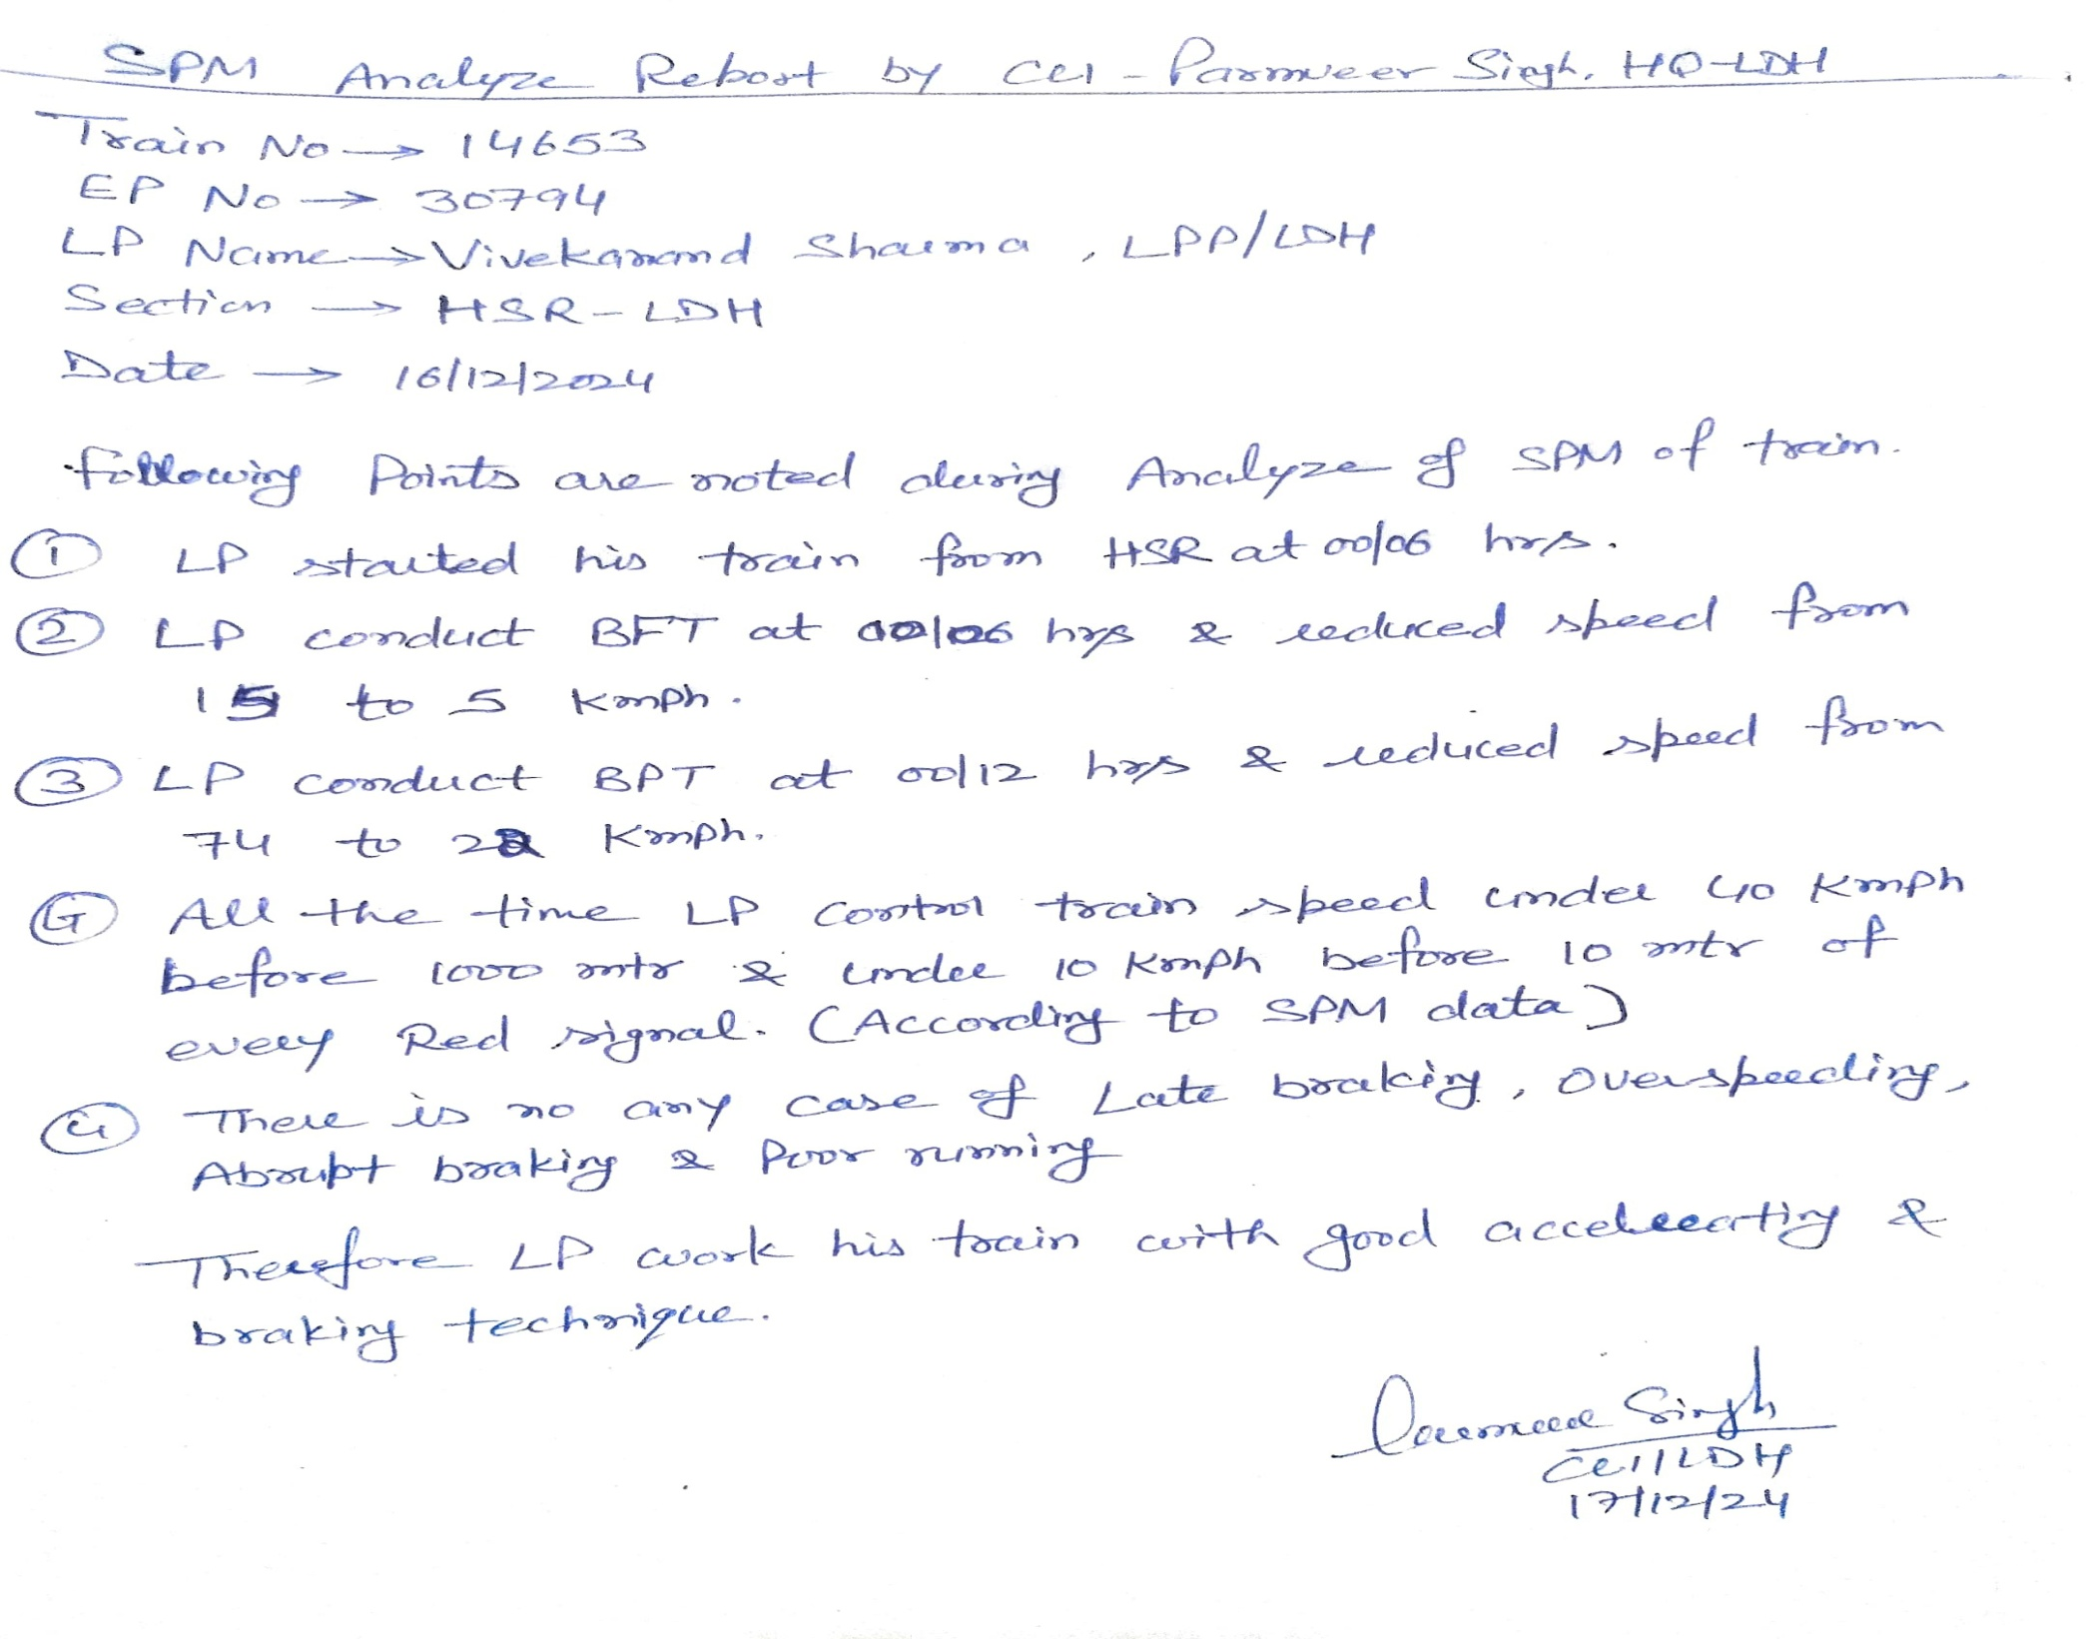

Slide 18
CASE STUDY-5

Slide 19
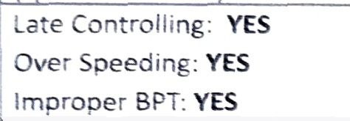
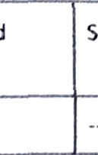
Average Speed: 55.76 kmph Total Time: 6:08:19ZZZZZZZZZZZZZZZZZZZZZZZZZZZZ
SPEEDOMETER DATA ANALYSIS-5
Journey Date: 15-12-2014
TRAIN No. 12478 (CHG)
SECTION SVDK -LDH
Report ID: 151224/1619
Loco Number: 37163/BL : SPM TELPRO
Time Range of Analysis: 10:06:40 AM - 4:14:56 PM
Abrupt Braking: YES
SR Overspeed: NO
Poor Running: NO
SPEED DROP: 77 - 55
BFT @ 10:07:07 AM
SPEED DROP: 5 - 2
SPEED WHILE APPROACHING STOP SIGNAL AT DANGER
 | SPEED B4 1000mtr | SFEEO B4 500mtr | SPEED B4 100mtr | SPECO B4 10mtr | Speed at Controil‹ng/ Braking Distance | BRAKlI‘tG Technique
 | 1 | 14 | 14 |  | 65kmph / 2.083 km | Smooth
 | 13 | 8 | 9 | 6 | 78kmph / 2.349 km | Smooth
 | 46 | 35 | 21 | 9 | 112kmph / 2.996 km | Late
 |  | 31 | 19 | 5 | 86kmph / 3.805 km | Late
 |  | 15 | 16 | 7 | 44kmph / 1.2S1 km | SmOOlR
 | 108 | lOS | 49 | 16 | 107kmph / 0.87 km | Abrupt
 | 25 | 27 | 16 | 9 | 29kmph / 0.924 km
SPEED RESTRICTIONS OBSERVED BY THE LP
Section

Slide 20
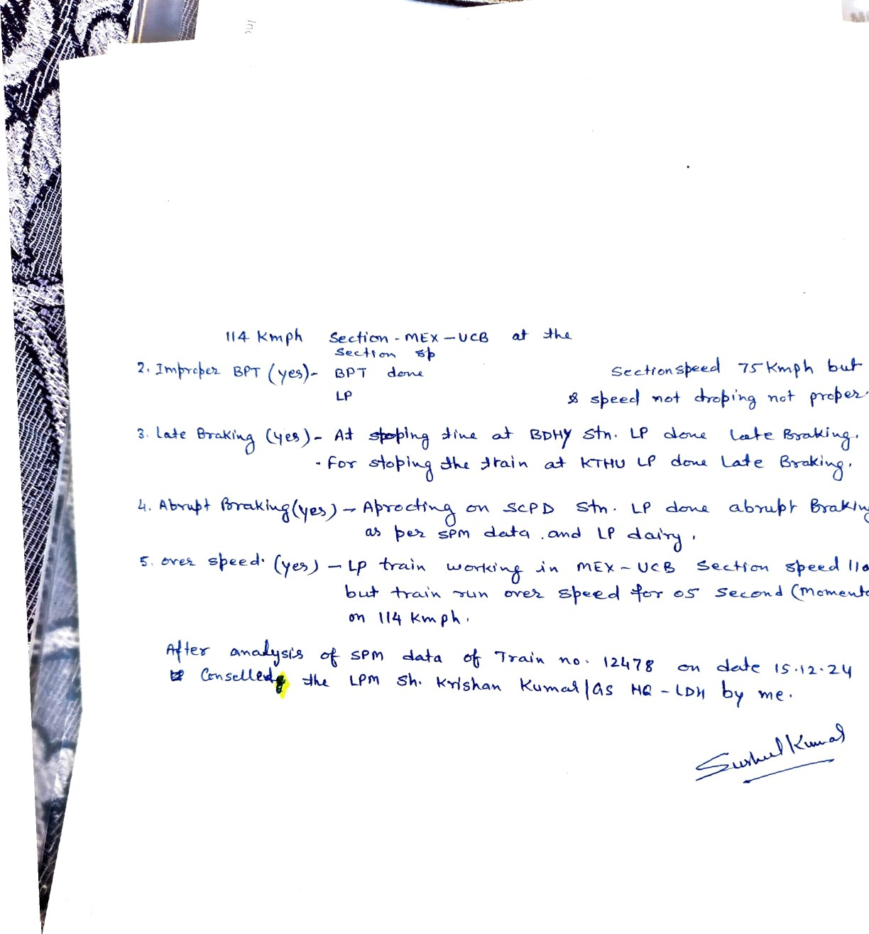
Indian Hailways

Slide 21
CASE STUDY-6

Slide 22
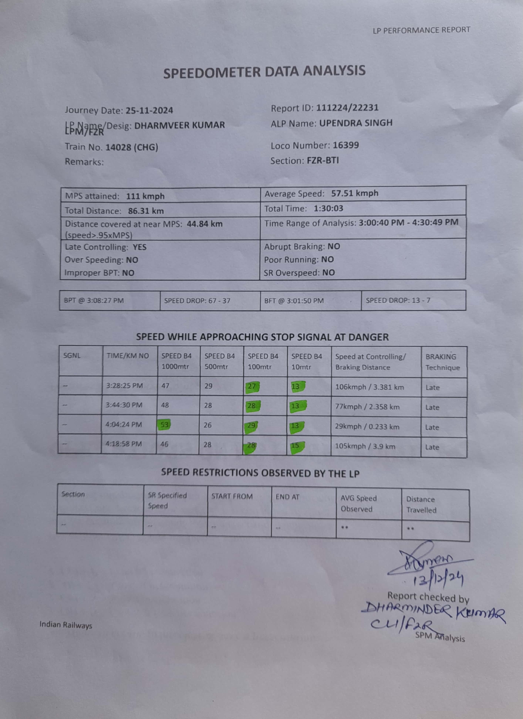

Slide 23
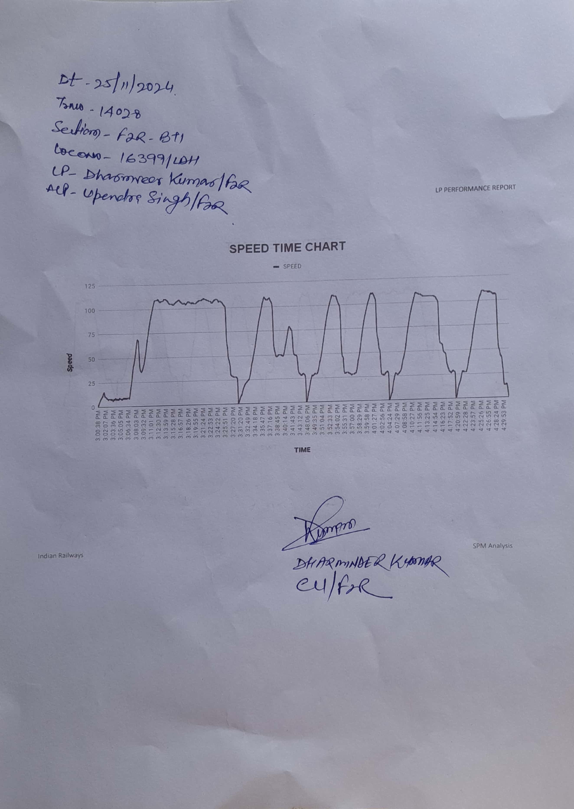

Slide 24
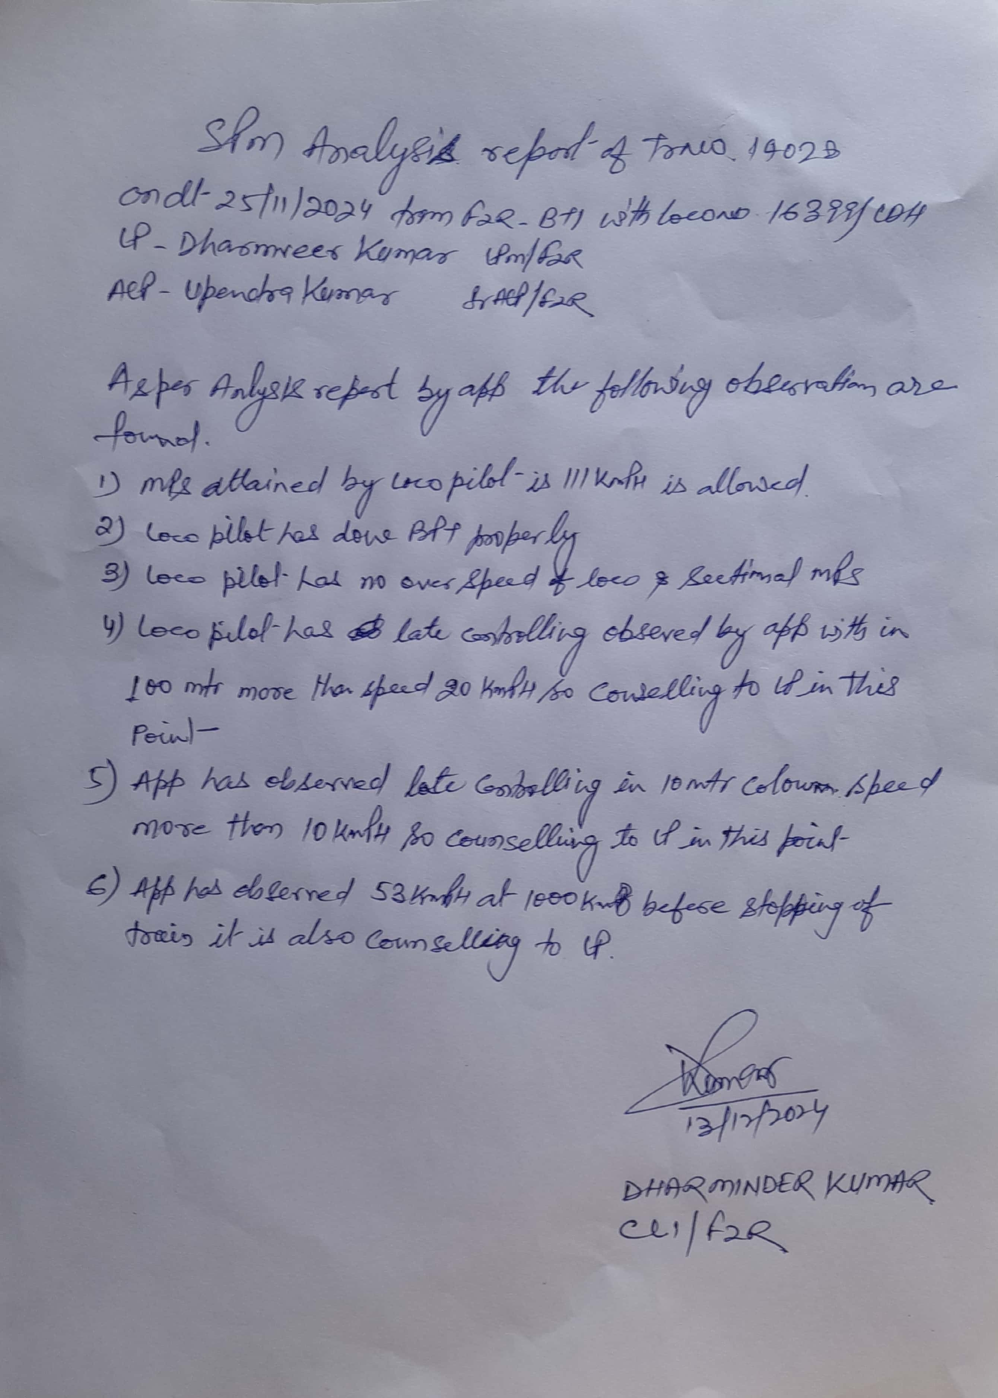

Slide 25
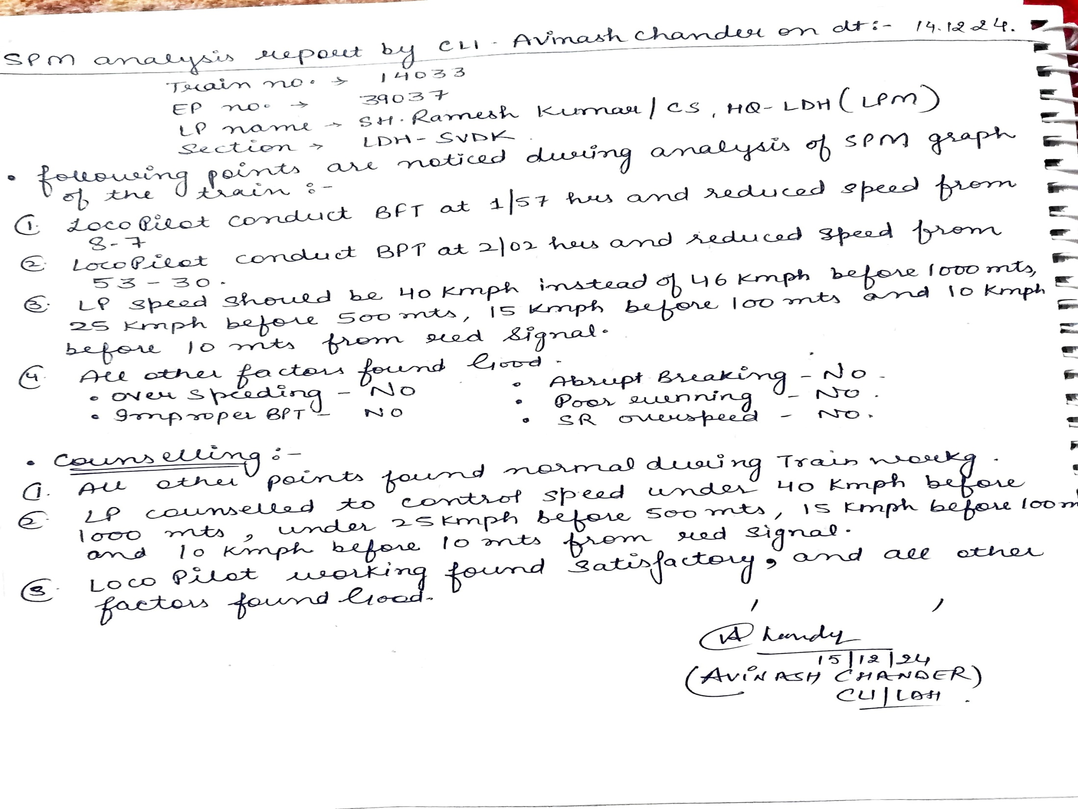

Slide 26
CASE STUDY-7

Slide 27
SPEEDOMETER DATA ANALYSIS-7
Journey Date: 20.12.24
LP Name/Desig:
Train No. 13151 (CHG)
Remarks: LDH-JAT
Report ID: 201224/16871
ALP Name:
Loco Number: 37116
Section: OTHER medha
MPS attained: 112 kmph | Average Speed: 50.31 kmph
Total Distance: 263.97 km | Total Time: 5:14:48
Distance covered at near MPS: 78.44 km (speed>.95xMPS) | Time Range of Analysis: 4:30:02 AM - 9:44:56 AM
Late Controlling: YES Over Speeding: NO Improper BPT: NO | Abrupt Braking: YES Poor Running: NO SR Overspeed: NO
BPT @ 4:32:45 AM | SPEED DROP: 58 - 33 | BFT @ -- | SPEED DROP: - -
SPEED WHILE APPROACHING STOP SIGNAL AT DANGER
SGNL | TIME/KM NO | SPEED B4 1000mtr | SPEED B4 500mtr | SPEED B4 100mtr | SPEED B4 10mtr | Speed at Controlling/ Braking Distance | BRAKING Technique
-- | 4:43:41 AM | 42 | 27 | 14 | 8 | 108kmph / 6.176 km | Late
-- | 5:07:32 AM | 25 | 26 | 14 | 8 | 106kmph / 5.281 km | Smooth
-- | 5:19:20 AM | 98 | 100 | 49 | 16 | 101kmph / 0.55 km | Abrupt
-- | 5:31:18 AM | 36 | 25 | 15 | 11 | 79kmph / 4.881 km | Late
-- | 6:30:58 AM | 28 | 29 | 13 | 8 | 29kmph / 0.905 km | Smooth
-- | 6:50:42 AM | 28 | 12 | 12 | 4 | 100kmph / 3.649 km | Smooth
-- | 6:57:56 AM | 29 | 30 | 13 | 9 | 29kmph / 1.34 km | Smooth
-- | 7:36:05 AM | 23 | 17 | 9 | 3 | 9kmph / 0.173 km | Smooth
-- | 7:42:56 AM | 29 | 28 | 10 | 4 | 29kmph / 0.979 km | Smooth
-- | 7:55:10 AM | 34 | 14 | 5 | 8 | 6kmph / 0.045 km | Smooth
-- | 8:15:18 AM | 39 | 12 | 10 | 8 | 80kmph / 3.964 km | Smooth
-- | 8:26:17 AM | 33 | 29 | 11 | 8 | 85kmph / 2.711 km | Smooth
-- | 8:44:26 AM | 14 | 27 | 11 | 9 | 28kmph / 0.398 km | Smooth
-- | 9:23:24 AM | 38 | 26 | 8 | 8 | 51kmph / 1.909 km | Smooth

Slide 28
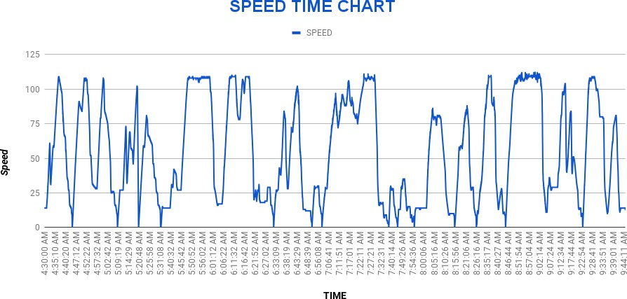

Slide 29
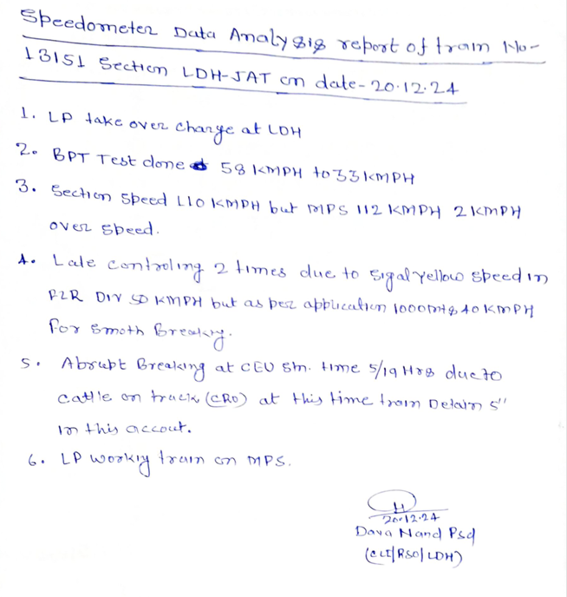

Slide 30
CASE STUDY-8

Slide 31
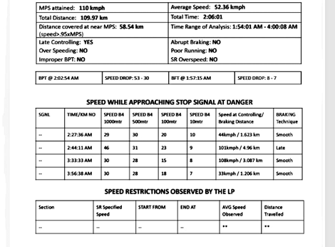
SPEEDOMETER DATA ANALYSIS-8
Journey date:-14/12/24
Train no 14033
Section LDH-SVDK
REPORT ID: 141224/21595
LOCO NO: 39037
SPM AUTOMETER

Slide 32
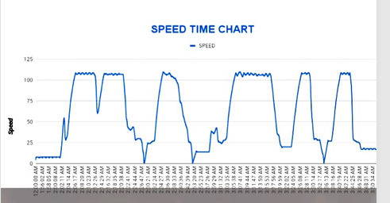

Slide 33
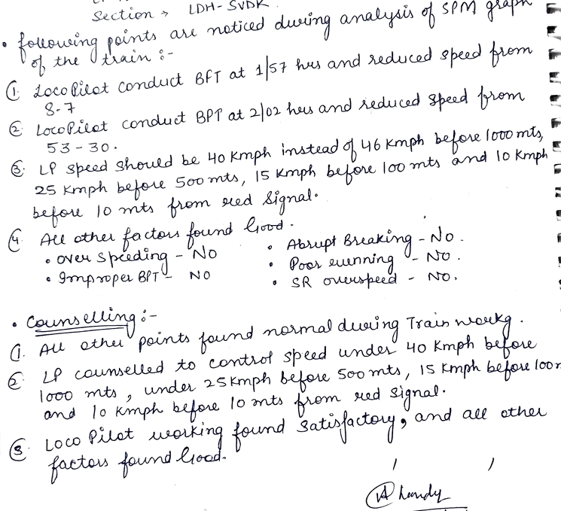

Slide 34
CASE STUDY-9

Slide 35
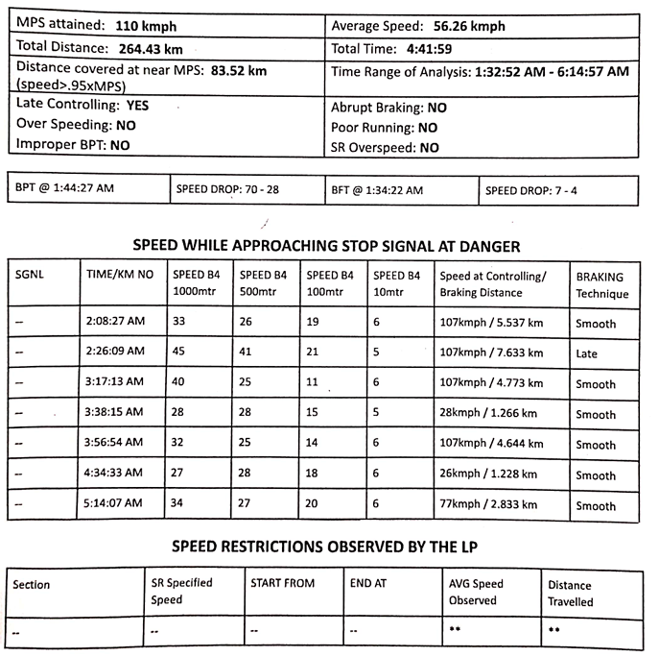
SPEEDOMETER DATA ANALYSIS-9
Journey Date;-15.12.24 Report ID -151224/16833
Train No.14661(CHG) Loco No.37559
Section;- LDH----JAT Spm- LAXVEN

Slide 36
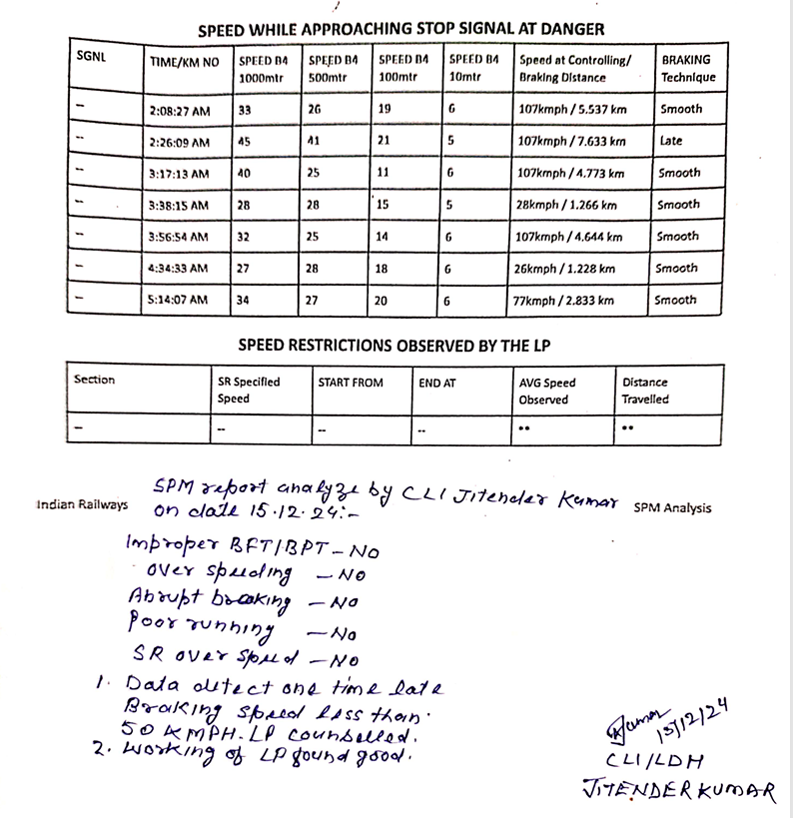

Slide 37
CASE STUDY-10

Slide 38
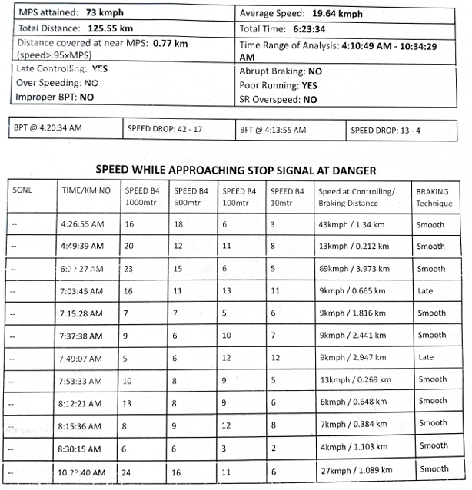
SPEEDOMETER DATA ANALYSIS-10
Journey Date-18.12.24 Report ID-201224/11278
Train No.Goods. Loco No.14801
Section-PTK---JUC SPM-MEDHA

Slide 39
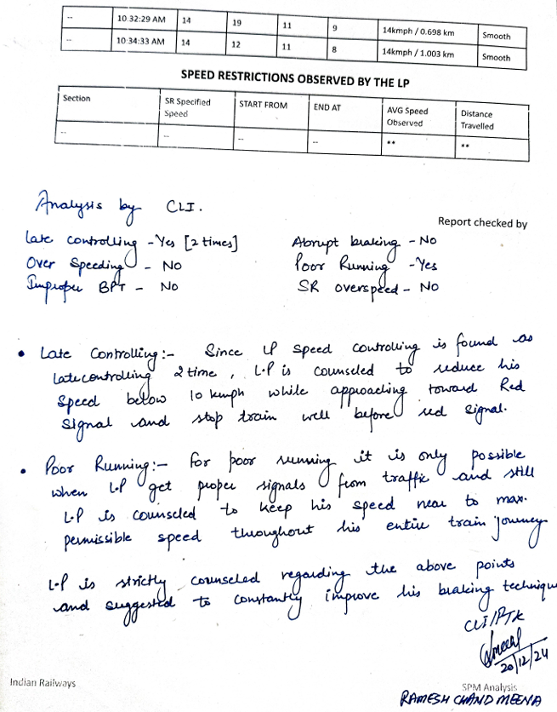

Slide 40
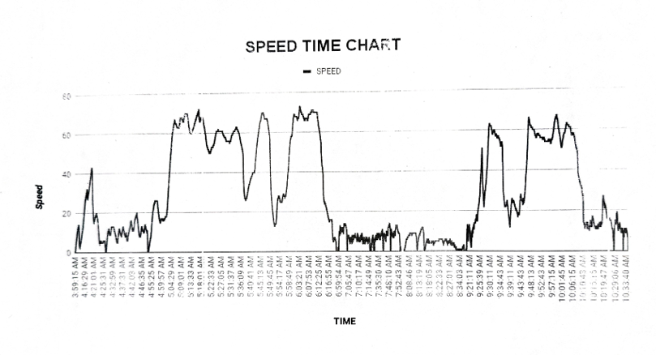

Slide 41
Summarization of SPM Data Analysis of FZR Division
 | FZR
1. Late Controlling | 25
2. Poor Running | 01
3. Improper BPT | NIL
4.Abrupt Braking | 06
5. Over Speeding | NIL
6. SR Over Speeding | NIL
विद्युत प्रशिक्षण केंद्र गाजियाबाद

Slide 42
निष्कर्ष
स्पीडोमीटर के Data Analysis के पश्चात् यह संज्ञान में आया है कि निम्न बिन्दुओ पर ध्यान देकर ड्राइविंग तकनीक मे सुधार किया जा सकता है वह गाड़ियों का सुरक्षित संचालन किया जा सकता है स्पीडोमीटर डाटा के अनुसार निम्न लिखित बिन्दुओ पर ध्यान देना आवश्यक है | 1. LATE BRAKING :- A) लोको पायलट को गाड़ी सञ्चालन के दौरान सिग्नल का संकेत एक पीला मिलने पर कोचिंग गाड़ी एवं खाली मालगाड़ी में गाड़ीकी गति अधिकतम 50 KMPH तथा भरी मालगाड़ी की गति 30 KMPH से अधिक नहीं होनी चाहिए। B) लोको पायलट द्वारा गाड़ी की गति रुकने के स्थान से 10 METER पहले 10 KMPH से अधिक नहीं होनी चाहिए।

Slide 43
2) BPT & BFT:- ब्रेक पॉवर टेस्ट व ब्रेक फील टेस्ट करने की विधि :-
BPT |  |  | BFT
विवरण | Coaching गाड़ी | मालगाड़ी | विवरण | Coaching गाड़ी | मालगाड़ी
गति | 60-70 Kmph | 30-50 Kmph | गति | 15 Kmph | 15 Kmph
प्रेशर ड्राप | 1 Kg/cm2 | 1 Kg/cm2 | प्रेशर ड्राप | 0.5 Kg/cm2 | 0.5 Kg/cm2
प्रेशर ड्राप होने के पश्चात गति | 30-35 Kmph | 15-25 Kmph | प्रेशर ड्राप होने के पश्चात गति | 5-10 Kmph | 5-10 Kmph
3) POOR RUNNING: लोको पायलट द्वारा गाडी का संचालन सेक्शनल स्पीड के अनुसार किया जाएगा, सभी प्रकार के गति प्रतिबन्धों का पालन करते हुए।
4) ओवर स्पीर्डिंग: किसी भी परिस्तिथि में ओवरस्पीडिंग नहीं किया जाएगा। अगर किसी कारणवश स्पीड अधिकतम स्पीड से 03 Kmph और 03 सेकंड से अधिक है तो इसे OVER SPEED माना जाएगा।
5) PSR व TSR: लोको पायलट द्वारा गति प्रतिबंध (PSR व TSR) का पालन कड़ाई से किया जाएगा एवं गति प्रतिवन्ध के पालन का तरीका GRADUALLY होना चाहिए गति प्रतिबन्ध बोर्ड के संकेत के अनुसार ।
6) ABRUPT BRAKING: गाड़ी संचालन के दौरान ब्रेकिंग GRADUALLY होनी चाहिए, PVEF का इस्तेमाल होना चाहिए ताकि WHEEL SKID से बचा जा सके। मगर किसी कारणवश अचानक ब्रेक लगाना पड़ता है तो लोको पायलट के संज्ञान में EMERGENCY BRAKING DISTANCE अवश्य होनी चाहिए।

Slide 44
7) GRADUALLY BRAKING: लोको पायलट द्वारा BRAKE POWER TEST के अनुसार A-9 द्वारा आवश्यक BRAKING DISTANCE को ध्यान में रखते हुए BP प्रेशर गिराया जाएगा। गाड़ी कंट्रोल के पश्चात AIR FLOW INDICATOR का भी ध्यान रखना चाहिए | गाड़ी की स्पीड सिग्रल के संकेत के अनुसार होनी चाहिए । गाड़ी की CONTROLLING इस प्रकार होनी चाहिए कि EMERGENCY BRAKE का इस्तेमाल EMERGENCY में ही हो जैसे MRO, CRO, अचानक SIGNAL का ON हो जाना, गाड़ी में, OHE में या TRACK पर कोई अन्य अवरोध दिखाई देने या होने पर इत्यादि ।
विद्युत प्रशिक्षण केंद्र गाजियाबाद

